Slide 1
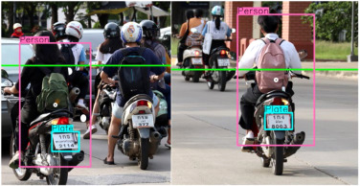
S.Gowtham
au412721205014

Slide 2
PROJECT TITLE
Bike Number Detection using CNN Algorithm

Slide 3


AGENDA
1.Data Collection: Gather a large dataset of images containing bikes, along with their corresponding bike numbers.
2.Data Preprocessing: Resize the images to a standard size, convert them to grayscale, and normalize the pixel values to improve model performance.
3.Feature Extraction: Use a CNN to extract relevant features from the images. CNNs are particularly effective for image processing tasks due to their ability to learn hierarchical representations of features.
4.Model Training: Split the dataset into training and validation sets. Train the CNN on the training set, optimizing its weights using an algorithm like stochastic gradient descent (SGD) or Adam.
5.Model Evaluation: Evaluate the trained model on the validation set to assess its performance. Use metrics like accuracy, precision, recall, and F1-score to measure the model's effectiveness.
6.Prediction: Once the model is trained and evaluated, it can be used to predict bike numbers in new images. The model takes an image as input and outputs the predicted bike number.
7.Improving Performance: Fine-tune the model by adjusting hyperparameters, using data augmentation techniques, or trying different architectures to improve its performance.Deployment: Deploy the trained model to a production environment where it can be used to predict bike numbers in real-time.
3/21/2024 Annual Review

Slide 4

PROBLEM STATEMENT
The problem is to develop a machine learning model that can accurately predict the number of bikes in an image. Given a dataset of images containing bikes along with their corresponding bike numbers, the goal is to train a model that can analyze new images and predict the number of bikes present.
This problem is challenging due to the variability in bike sizes, orientations, and background clutter in the images. The model needs to be able to extract relevant features from the images and generalize well to unseen data to make accurate predictions.

Slide 5

PROJECT OVERVIEW
1.Data Collection:
Gather a dataset of images containing bikes.
Label each image with the corresponding number of bikes.
2.Data Preprocessing:
Resize images to a standard size.
Convert images to grayscale.
3.Model Architecture:
Use a Convolutional Neural Network (CNN) for feature extraction.
4.Model Training:
Split the dataset into training and validation sets.
Train the model on the training set.
5.Model Evaluation:
Evaluate the trained model on the validation set.
Use metrics like accuracy, precision, recall, and F1-score.

Slide 6
WHO ARE THE END USERS?
1.Traffic Management Authorities: They can use the model to estimate the number of bikes on the roads, which can help in planning and optimizing traffic flow.
2.City Planners: By knowing the bike traffic, they can design better infrastructure such as bike lanes and parking spaces to accommodate the growing number of cyclists.
3.Bike Sharing Companies: They can use the model to track the usage of their bikes and optimize their bike allocation and distribution strategies.
4.Researchers: Researchers in transportation and urban planning can use the model to study bike usage patterns and trends.
5.General Public: The model's insights can be used by the general public to make informed decisions about biking routes and times based on predicted bike traffic

Slide 7

SOLUTION AND VALUE PROPOSITION VALUE PROPOSITION
1.Efficient Traffic Management: By accurately predicting bike numbers, traffic management authorities can better plan and optimize traffic flow, reducing congestion and improving overall efficiency.
2.Urban Planning Optimization: City planners can use the predicted bike numbers to design better infrastructure, such as bike lanes and parking spaces, to accommodate the growing number of cyclists.
3.Resource Allocation: Bike sharing companies can optimize their bike allocation and distribution strategies based on the predicted bike traffic, leading to more efficient use of resources.
4.Data-Driven Decision Making: Researchers and policymakers can use the model's insights to make data-driven decisions regarding transportation and urban planning, leading to more effective policies and interventions.

Slide 8

THE WOW IN YOUR SOLUTION
1.Accuracy: The use of Convolutional Neural Networks (CNNs) enables the model to extract complex features from images, leading to more accurate predictions compared to traditional machine learning models.
2.Real-Time Prediction: The model can be deployed in a real-time environment, allowing for on-the-fly estimation of bike numbers, which can be invaluable for traffic management and urban planning.
3.Scalability: The model can scale to handle a large number of images, making it suitable for analyzing bike traffic in cities with high volumes of cyclists.
4.Generalization: The model's ability to generalize well to unseen data ensures that it can provide reliable predictions even in varying conditions, such as different bike sizes, orientations, and backgrounds.
3/21/2024 Annual Review
8

Slide 9
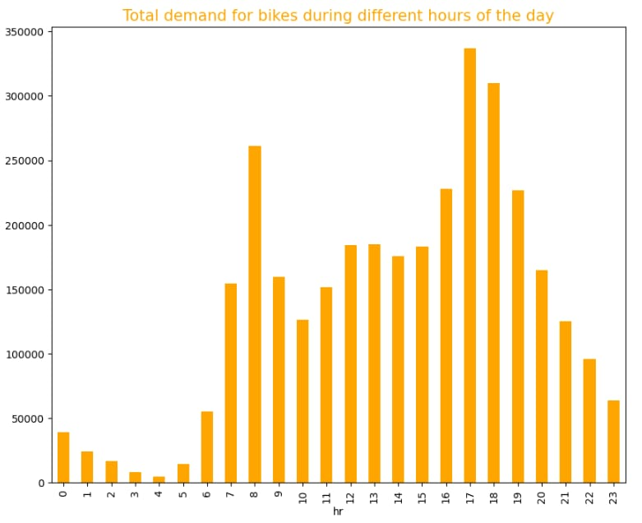
MODELS
9

Slide 10
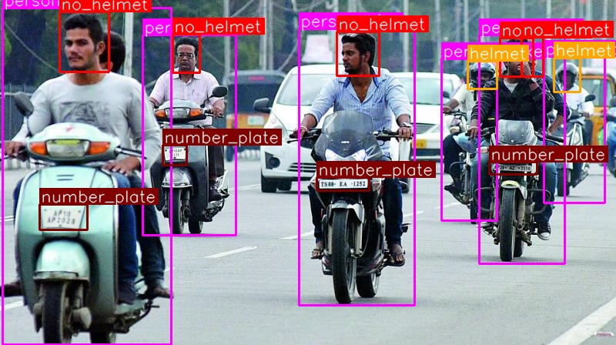
RESULT
10

